Slide 1
First Impression

Slide 2
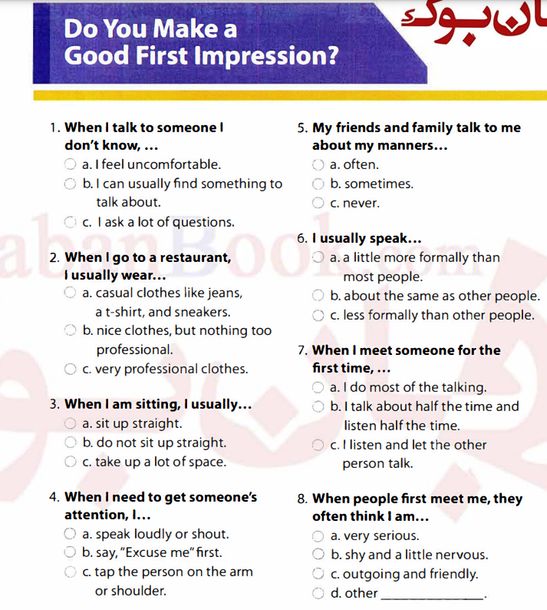

Slide 3
How to make a strong first impression
You have only one chance to make a first impression.
You get 10 seconds with stranger before they form an opinion of us.

Slide 4
Body language and Appearance
Demonstrate a good attitude with your body
Show confidence
Make eye contact and stand straight
Standard dress code

Slide 5
Voice
The way you speak affects the first impression.
Select words to show level of knowledge
Change the pitch to avoid monotone

Slide 6
Conversation skills
Show you are interested in others and appreciate them.
Have good listening skills
Maintain steady eye contact

Slide 7
What to avoid
Avoid making other uncomfortable
Be careful with jokes
Don’t offend others
Don’t just disagree with someone you just met
Avoid anything that is political, judgmental, controversial, emotionally charged, opinionated or too personal
Avoid asking for money

Slide 8
Job Interviews
Be prepared and stay professional at all the times
Dress professionally
Be punctual
Make eye contact
Be polite
Talk about accomplishments
Don’t interrupt
Avoid slang or bad words
Don’t exaggerate your accomplishments
Don’t lie
Don’t be negative
Avoid complaining about past jobs
What to do?
What not to do?

Slide 9
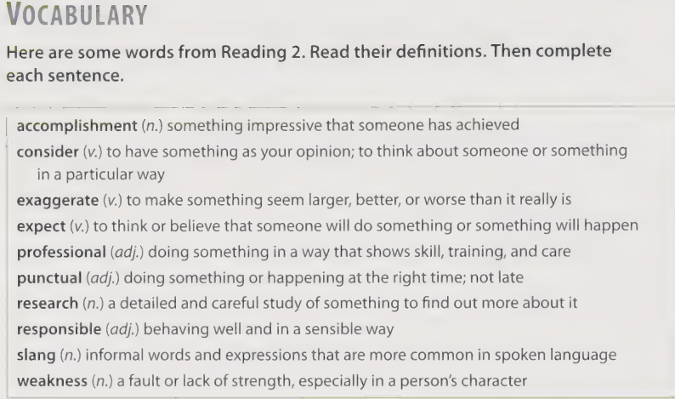
Vocabulary

Slide 10
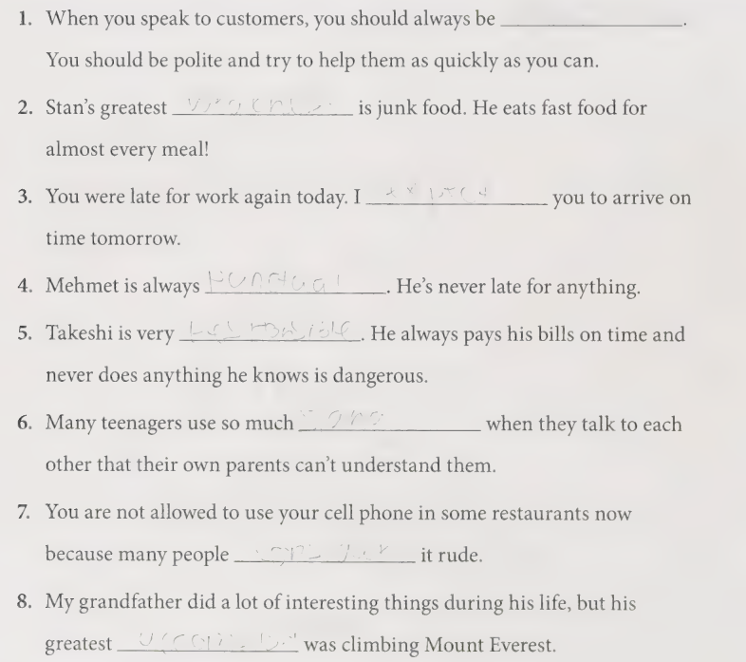

Slide 11
Noun | Verb | Adjective | Adverb
Accomplishment | Accomplish | Accomplished | -
 |  | Considerable | Considerably
Confidence | -
 | Demonstrate |  | -
 | Impress |  | -
 | Offend
 | - | Responsible
 | Select

Slide 12
